Slide 1








A General suspiciousness metric for dense blocks in multimodal data
Meng Jiang, University of Illinois at Urbana-Champaign, USA
Joint work with
Alex Beutel (CMU), Peng Cui (Tsinghua), Bryan Hooi (CMU),
Shiqiang Yang (Tsinghua), Christos Faloutsos (CMU)
Notes:
Thank the session chair.
Introduce myself and the title.
Alex, Bryan, Christos from CMU, Peng and Shiqiang from Tsinghua. This work was done when I was in Tsinghua.
Three terms later.

Slide 2
ROADmap
1. Motivation & Problem
2. Proposed Method
3. Experiments

Slide 3

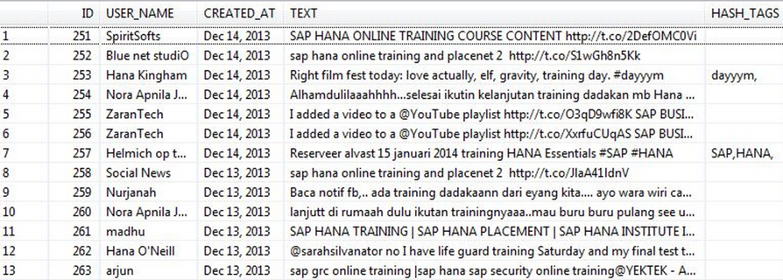
Suppose You Work in Twitter
My boss wants me to
catch fraud in such a big table – billions of records, tens of columns!!! How?!
fraud
Notes:
Let me tell you our motivation. Suppose you work in Twitter, because you love big data, and Twitter has big data,
Your boss gives you the data. He wants you to find what is worth inspecting, which could be fraudulent messages, or promotional information.
But the data table is too big. It may have billions of records and also tens of columns.
It has user information, Johnson and Thompson, time information, and text information including hashtag, URL and many other information.
So this big data has multiple modes.

Slide 4
Massive Multi-Modal Data: Lines (Mass) & Columns (Mode)
Dataset | Mode |  |  |  | Mass
Retweeting | User | Root ID | IP | Time (min) | #retweet
 | 29.5M | 19.8M | 27.8M | 56.9K | 211.7M
Trending (Hashtag) | User | Hashtag | IP | Time (min) | #tweet
 | 81.2M | 1.6M | 47.7M | 56.9K | 276.9M
Network attacks (LBNL) | Src-IP | Dest-IP | Port | Time (sec) | #packet
 | 2,345 | 2,355 | 6,055 | 3,610 | 230,836
Notes:
Let’s take a look at the multi-modal data we have. Retweet hijacking and trend manipulating.

Slide 5

Suspicious Behaviors in Multi-Modal Data
Notes:
We have seen lots of IT news about the companies who have monetary incentives,
working at some locations, with a group of IP addresses/machines, manipulating their fake Twitter accounts.
They inject suspicious behaviors into the dataset. Their messages are often social fraud.

Slide 6


Dense Blocks Indicates Suspiciousness
200 minutes
time
225
user
27,313
Notes:
We find that the injected suspicious behaviors create dense blocks. Suppose we can observe the user and time modes. An example for a dense block is we spot…

Slide 7
Dense Blocks Indicates Suspiciousness
120 minutes
time
user
40
IP
12,375
2
Notes:
What if we have another mode of information, say, IP address? Now we have 3-mode data and a 3-mode block. See we spot…

Slide 8
Dense Blocks Indicates Suspiciousness
120 minutes
time
+Hashtag
+URL
+Product
+Location
+…
user
40
IP
12,375
2
Notes:
Twitter can collect lots of signals. We may have more modes, such as, … Different types or strategies of the social fraud may create density in different modes. For example, the fraudsters may use similar hashtags, or they use similar URLs.

Slide 9
Dense Blocks Indicates Suspiciousness
200 minutes
120 minutes
time
time
user
225
user
40
IP
12,375
2
27,313
Question: Which is more suspicious?
We need a metric to evaluate the suspiciousness.
Notes:
The problem is given us these two blocks of different modes, which is more suspicious? For the dense blocks, before we search them, we should be able to evaluate their suspiciousness. So we need a metric.

Slide 10
Roadmap
1. Motivation & Problem
2. Proposed Method
3. Experiments

Slide 11
Metric Criteria
What properties are required of a good metric?
N₁ ⨉ N₂ ⨉ N₃
Count data with total “mass” C
f(
)
f(
n’₁ ⨉ n’₂ ⨉ n’₃
mass c’
density ρ’
)
n₁ ⨉ n₂ ⨉ n₃
mass c
density ρ
vs
Notes:
Suppose there is a metric function f. The parameters are … size/volume, mass, or density of both data and a block. Mass, for example, could be the number of messages. To compare these two suspiciousness values of the two blocks, what properties…?

Slide 12
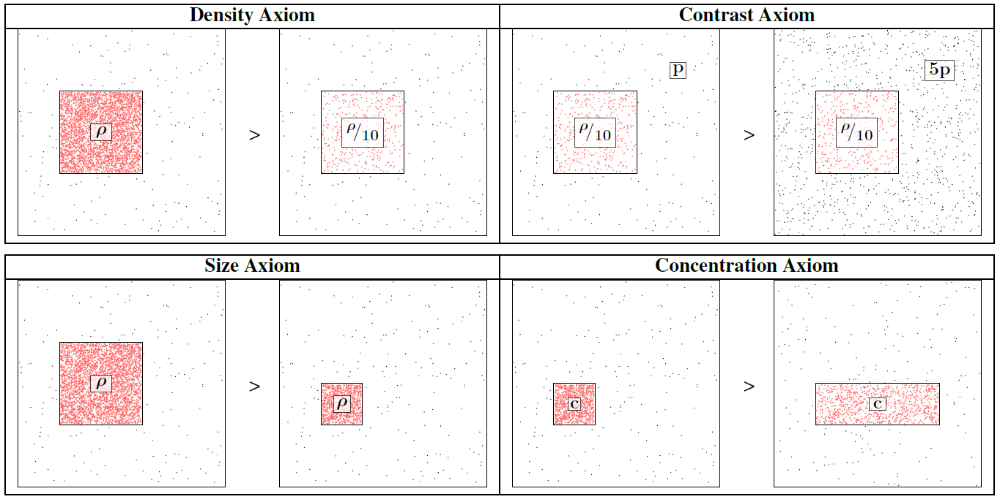
Axioms 1-4
Notes:
Density: with the same size, if a block is denser, it’s’ more suspicious.
Contract: with the same block, the data is sparser, the block…
Size: with the same density, if the block is bigger, it’s…
Concentration: with the same count, the block is smaller, it’s…

Slide 13
Axiom 5: Multimodal
Not including a mode is the same as
including all values for that mode.
=
▶ New information (more modes) can only
make our blocks more suspicious
Notes:
Not including a mode should equal with including all values for that mode.
So, …

Slide 14
Our Principled Idea: Scoring Suspiciousness
200 minutes
120 minutes
time
time
user
225
user
40
IP
12,375
2
27,313
Notes:
It is challenging to give a score function to evaluate dense blocks in multi-modal data, because the score function or the metric should satisfy all the five axioms. Let’s take three seconds to think of one. One, two, three… See, it’s hard, right? We used three weeks to find the metric and prove its properties, three months to do the experiments. It’s hard to solve this problem in three seconds.

Slide 15
Our Principled Idea: Scoring Suspiciousness
200 minutes
120 minutes
time
time
user
225
user
40
IP
12,375
2
27,313
Probability
0.9%
0.05%
Notes:
If I told you the probability of their occurrence?

Slide 16
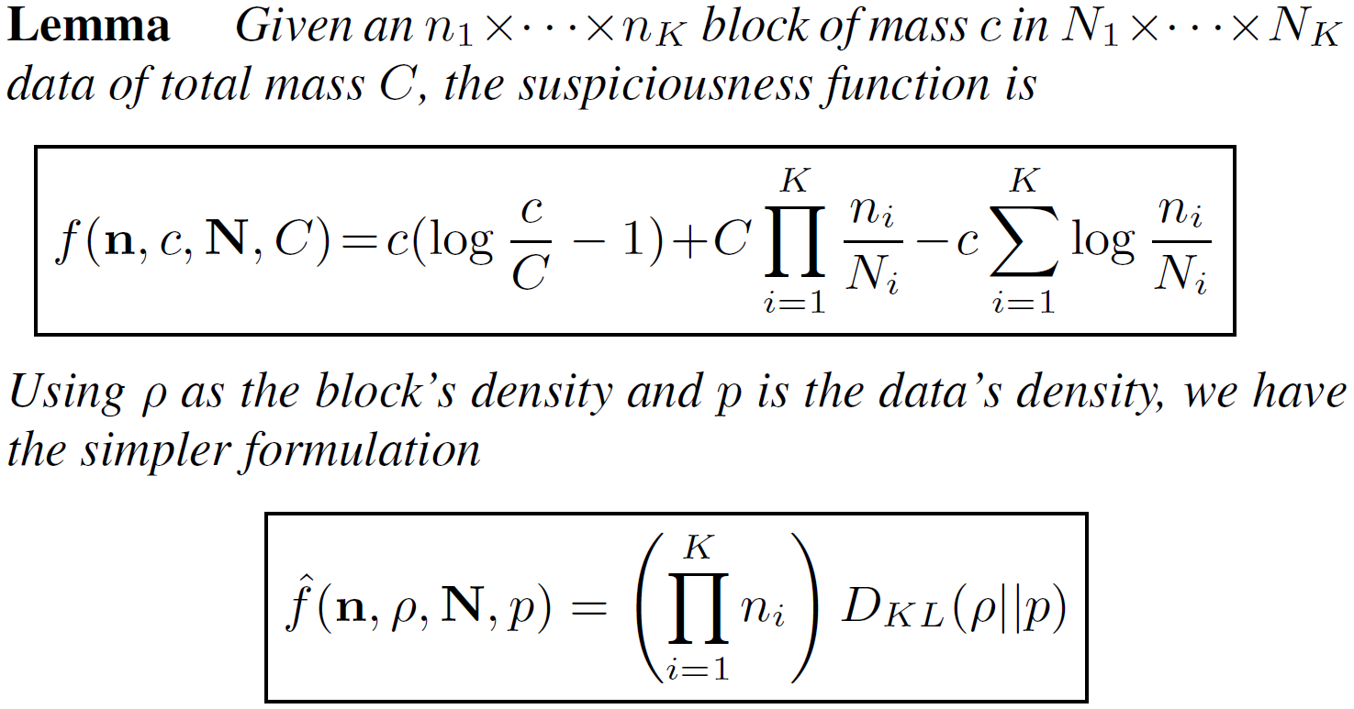
A General Suspiciousness Metric
Negative log likelihood of block’s probability

Slide 17
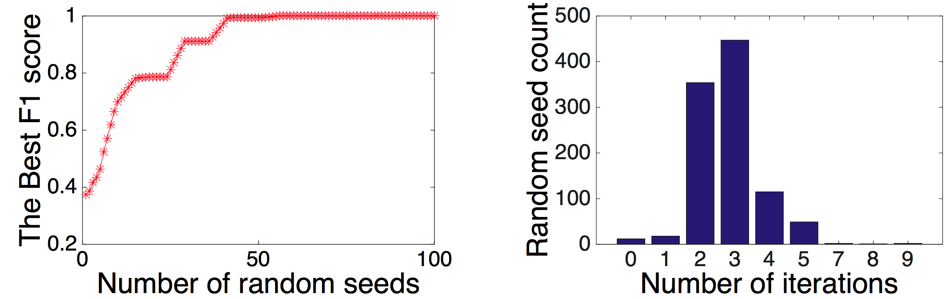
CrossSpot: Local Search with the Metric
Seed block, adjust modes, select a mode, adjust values in mode, until convergence.
Seed selection: HOSVD, or with LockInfer [PAKDD’14]
Fast convergence
Parallelize to multiple machines: Scalable!

Slide 18
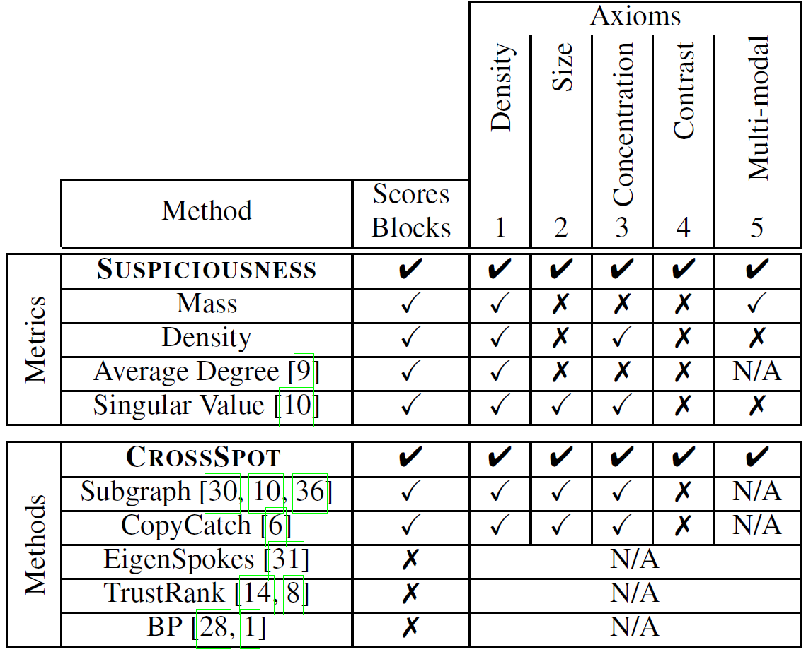
Advantage: “Suspiciousness”+CrossSpot
Score dense blocks
Target multi-modal data
Satisfy all the axioms

Slide 19
roadmap
1. Motivation & Problem
2. Proposed Method
3. Experiments

Slide 20
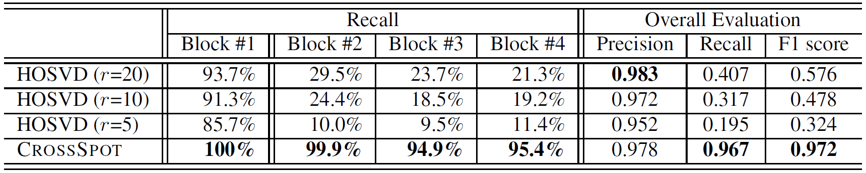
Performance: Synthetic Data
Experiments: Synthetic data
1,000×1,000×1,000 of 10,000 random data
Block#1: 30×30×30 of 512 3 modes
Block#2: 30×30×1,000 of 512 2 modes
Block#3: 30×1,000×30 of 512 2 modes
Block#4: 1,000×30×30 of 512 2 modes

Slide 21
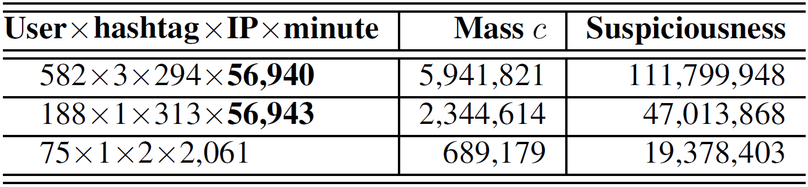
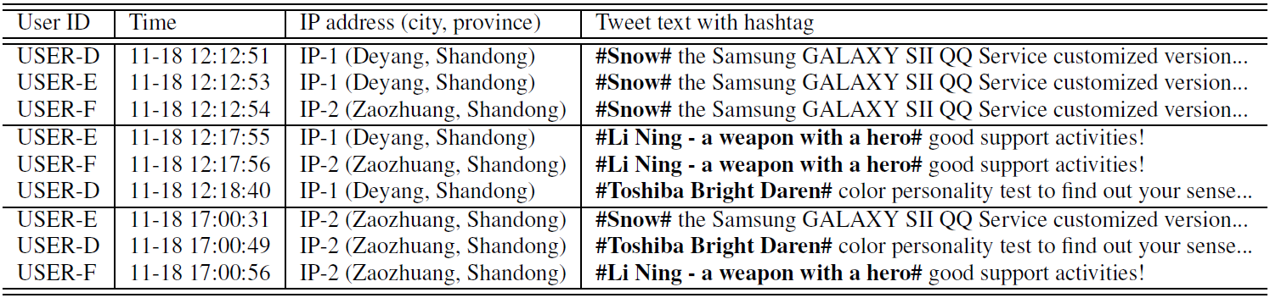
Performance: Manipulating Trends

Slide 22
Performance: Network Blocks
Notes:
These subsets of events take all the values in time mode, forming 3-mode dense blocks in 4-mode data. The cross- mode results indicate that a group of source IP addresses continuously send packets to multiple destination servers with the same group of ports in every second of one hour.

Slide 23
Conclusion
Proposed a general “suspiciousness” metric based on probability for multi-modal behaviors
CrossSpot: Proposed a local search algorithm for catching suspicious behaviors
Thank you!
Meng Jiang, UIUC
mjiang89@gmail.com
www.meng-jiang.com

Slide 25
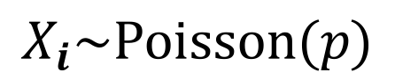
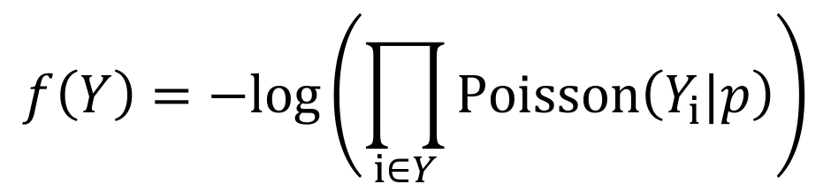
(Erdös-Rényi-)Poisson Model
$$X_{i}\sim Poisson(p)$$
$$f\left(Y\right)=−log⁡\left(\prod_{i∈Y}{Poisson\left(Y_{i}|p\right)}\right)$$
Suspiciousness metric is the negative log-likelihood of the sub-block’s mass

Slide 26
Suspiciousness Metric
Suspiciousness metric is the negative log-likelihood of the sub-block’s mass

Slide 27
Suspiciousness Metric
Satisfies all axioms!

Slide 28
Search Algorithm
Can use previous methods to seed algorithm
Find optimal* subset of indices in mode j in O(N_{j} log N_{j}) time.
*Optimal given other modes are held constant.

Slide 29
Synthetic Tests (Matrix)

Slide 30
Synthetic Tests (3-mode Tensor)

Slide 31
Synthetic Tests (3-mode Tensor)

Slide 32
Suspicious Retweet Blocks

